Slide 1
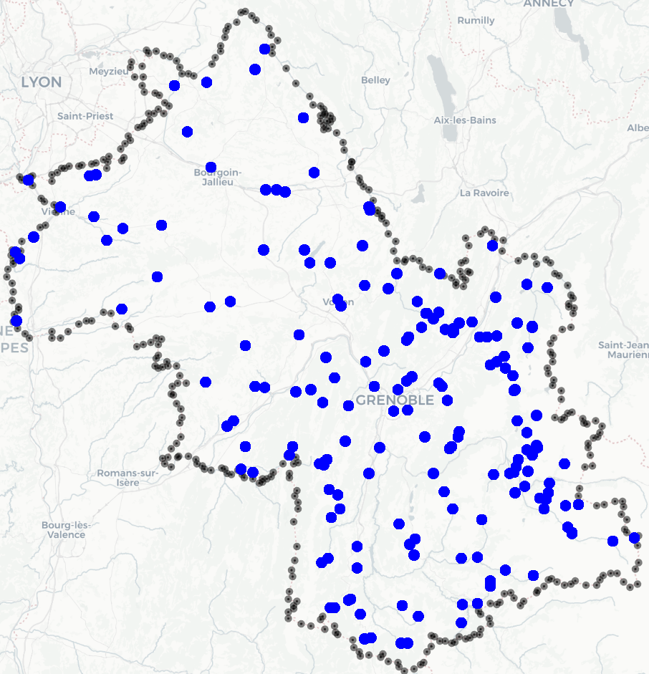


Cleaning
154 Stations, when merged 56
1 million entries from 1952 to 2022
main variable: Precipitation (rain)
co variables: altitude, longitude,
Map with all the stations

